Slide 1
Operating System

Slide 2
Syllabus, Course Outcomes, Objectives, Exam pattern
Refere syllabus copy

Slide 3




Operating System
A program that acts as intermediary between user of a computer and computer hardware
Operating System
Notes:
Basically OS acts as message exchanger between user and the different parts of computer hardware.
It is a piece of software that perform various operations on behalf of user by communicating with hardware. As a human it is bit difficult to communicate using electrical signals to hardware.

Slide 4
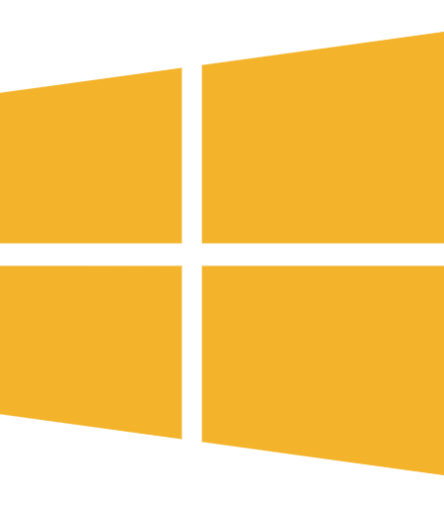
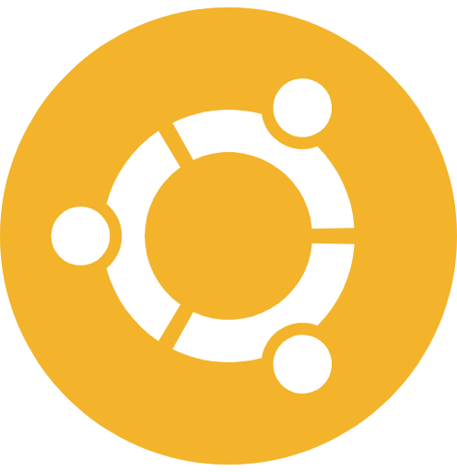
Operating System - Goals
Execute programs and make solving user problems easier
Make computer system convenient to use
Use hardware in efficient manner
Notes:
Programs like firefox, wordpad, media player etc. are executed by OS.
The basic requirement of Os to make interface convenient to use.
There are limited number of resources such as memory, HDD, processor, io devices etc. One of the OS job is to handle these resources efficiently because multiple applications/user operating concurrently on a system.

Slide 5
Computer System - Structure
Hardware
Operating System
Application Program
Users
Notes:
A computer system is broadly divided into 4 components Hardware, OS, Application programs and users.

Slide 6


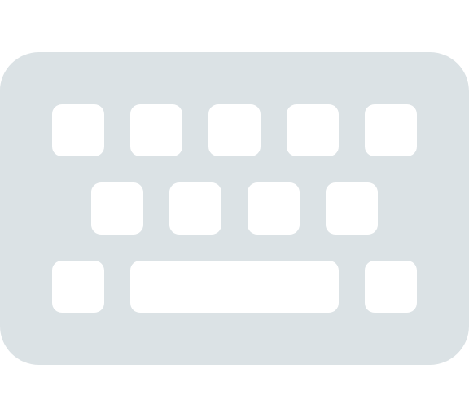

Computer System - Structure
Hardware
Monitor
Keyboard
Mouse
Processor
Hard-disk
RAM
Notes:
Hardware components includes processing device, I/O device,and Storage device. Processing device includes processors, cores which performs computations associated to any software program. Output devices such as monitors, speakers, displays, etc. provides the output in the form of text, audio, video, images etc. Input devices such as mouse, keyboard receives input from user. Finally the storage devices such RAM, Cache, HDD, SSD, registers etc, stores the information. The job of OS to manage all the activities performed by these components or rather effective management. We will discuss functions of all components at OS level in subsequent sessions.

Slide 7
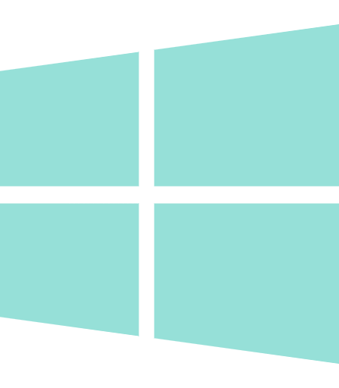

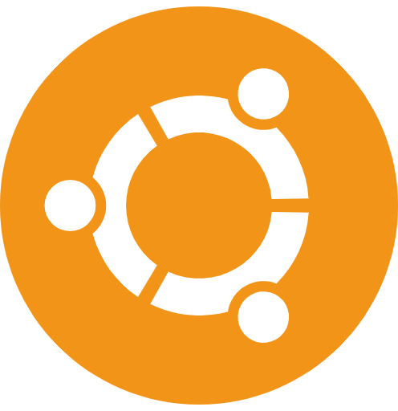

Computer System - Structure
Operating System
Controls and coordinates use of h/w among applications and
users
Notes:
The OS is a second component of a computer system. As mentioned earlier the OS acts as intermediary between hardware and user. Basic functionality of all OS is same like process management, storage management, file management.
A user can directly communicate using electric signals but it becomes complex.
Then OS came into picture to perform all these jobs on behalf of user.
For example, to create a folder we can use mouse and command prompt also or maybe using signals.

Slide 8






Computer System - Structure
Application Programs
Define the way in which the system resources are used to solve the computing problems of the users
Notes:
To communicate with OS also bit hard as user needs to understand system level commands. Earlier low level programming was used to provide commands to OS. User has to understand OS level commands. To overcome this application programs are developed. Application programs directly communicate with OS by demanding resources and now OS manages all the application request. As the layers on top of OS increases the users interface becomes more convenient.

Slide 9


Computer System - Structure
Users
User can be a human, a device or another computer.

Slide 10

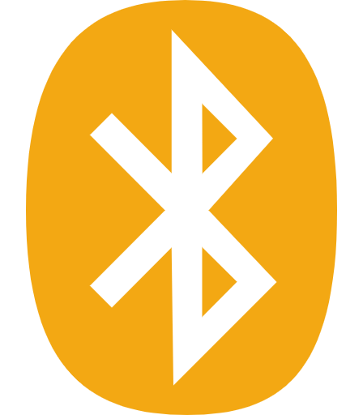

Computer System - Structure
Users
Application Programs
Operating System
Computer Hardware
Notes:
This is how a computer system works.
User starts an application lets say wordpad.
OS allocates memory for the wordpad application in RAM.
The data and code brought into RAM.
All instructions gets executed by CPU.
Once application is closed all data related to wordpad gets removed from RAM.
All these operations are performed by along with other applications.

Slide 11

What Operating System Do?
Controls the hardware and coordinates its use among the various application programs for the various users
Provides means for proper use of resources in the operation of computer system
OS is like government, it simply provides an environment within which other programs can do useful work
To understand OS role, we need to explore OS from two viewpoints
The user
The system

Slide 12


User’s view of Operating System
Single user computers - Such systems are designed for one user to monopolize its resources. Eg. PC, Workstations. The goal is to maximize the work that the user is performing. The operating system is designed mostly for ease of use and good performance.

Slide 13

User’s view of Operating System
Multi user computers - These users share resources and may exchange information. The operating system in such cases is designed to maximize resource utilization to assure that all cpu time memory and i/o are used efficiently and that no individual users takes more than their fair share.

Slide 14




User’s view of Operating System
Handheld Computers - The user interface for mobile computers generally features a touch screen. The systems are resource poor, optimized for usability and battery life.

Slide 15


User’s view of Operating System
Embedded computers - The user interface may have numeric keypads and may turn indicator lights on or off to show status. The operating systems are designed primarily to run without user intervention.
Ropeway m/c
Cash-counter

Slide 16
System view of Operating System
From computer’s point of view, the OS is a program most intimately involved with the hardware. There are two different views
The operating system is resource allocator
Manages all resources.
Decides between conflicting requests for efficient and fair resource use.
The Operating system is a control program
Controls execution of program to prevent errors and improper use of the computer

Slide 17
More common definition of OS
The operating system is one program running at all times on the computer usually called kernel.
Along with the kernel there are two types of programs
System programs - Associated with the OS but are not necessarily part of of the kernel.
Application programs - Which includes all programs not associated with the operation of the system.
The system programs are used to program the operating system software. While application programs provide software that is used directly by the user, system programs provide software that are used by other systems such as device driver, compilers, computational science applications etc.

Slide 18

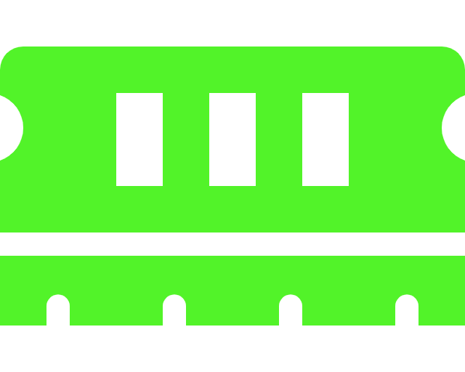
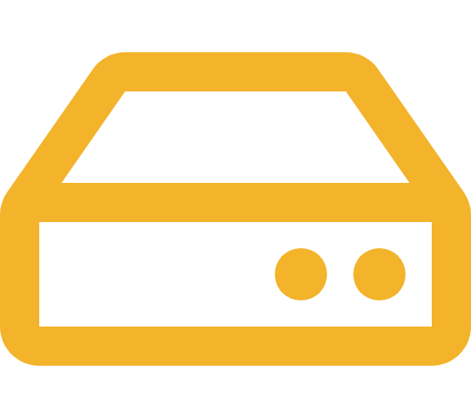

How computer starts?
ROM
Memory
HDD
RAM
Power button pressed
2. Load bootstrap program from ROM
3. Load OS into RAM from disk
Notes:
The first thing a computer has to do when it is turned on is to start up a special program called an operating system.
The boot process is something that happens every time you turn your computer on.
You don’t really see it, because it happens so fast.
You press the power button come back a few minutes later and Windows XP, or Windows Vista, or whatever Operating System you use is all loaded.
POST (Power On Self Test) The Power On Self Test happens each time you turn your computer on.
It initializes the various hardware devices. It is an important process so as to ensure that all the devices operate smoothly without any conflicts.
A non volatile memory where a small program Master Boot Record is kept. MBR starts execution immediately after POST. Bootstrap loader loads OS from HDD (generally stored on first sector of disk).

Slide 19
Storage Structure
Storage
Main
Memory
Secondary
Memory
Tertiary
Storage
CPU can access directly
Random Access
Mostly volatile
HDD
SSD
Non volatile
Slower
Magnetic Tape drives

Slide 20
Storage Device Hierarchy
Registers
Faster
Primary
Smaller
Volatile
Cache
Main Memory
Non
Volatile
Non volatile memory
Secondary
Magnetic Disks
Optical Disks
Tertiary
Larger
Slower
Magnetic Tapes

Slide 21
Performance of various levels of storage
Level | 1 | 2 | 3 | 4 | 5
Name | Registers | Cache | Main Memory | SSD | Magnetic Tapes
Typical Size | <KB | <16MB | <64GB | <1TB | <10TB
Access Time (ns) | 0.25 - 0.5 | 0.5 - 25 | 80 - 250 | 25000 - 50000 | 5000000
Bandwidth (MB/s) | 20,000 - 100000 | 5000 - 10000 | 1000 - 5000 | 5000 | 20 - 150
Managed by | Compiler | Hardware | Operating System | Operating System | Operating System

Slide 22
IO structure
A general purpose computer system consists of CPU and multiple device controllers that are connected through a common bus
Each device controller is in charge of specific type of device.
More than one device may be attached.
A device controller maintains some local buffer storage and set of special purpose registers.
The device controller is responsible for moving the data between the peripheral devices that it controls and its local buffer storage.
Typically, OS have a device driver for each device controller

Slide 23
Computer System Architecture
Computer System Architecture
Increased throughput
Economy of scale
Increased reliability -
If one fails other performs
Single Processor
Multi-processor
Symmetric
multi-processor
Asymmetric
multi-processor
Each processor perform all task
Each processor perform
specific task

Slide 24
Operating System Operations
Process Management
Memory Management
Storage Management
File management
Protection and Security

Slide 25
Operating System Operations
Process Management
A process is program under execution. Program is a passive entity and process is an active entity.
Process needs resources such as CPU, memory, files, registers, i/o devices, etc. to accomplish a task
Typically system has many processes some user and some operating system running concurrently on one or more CPUs

Slide 26
Operating System Operations
Process Management Activities
Creating and deleting user and system processes
Suspending and resuming processes
Providing mechanism for process synchronization
Providing mechanism for process communication
Providing mechanism for deadlock handling

Slide 27
Operating System Operations
2. Memory Management
To execute a program all (or part) of the instruction must be in main memory
All (or part) of the data that is needed by the program must be in memory
Memory management determines what is in the memory and when to optimize CPU utilization and computer response to user

Slide 28
Operating System Operations
2. Memory Management Activities
Keeping track of which parts of memory are currently being used and by whom
Deciding which processes (or parts thereof) and data to move into and out of memory
Allocating and deallocating memory space as needed

Slide 29
Operating System Operations
3. Storage Management
OS provides uniform, logical view of information storage (Don't know whether program is on hdd, memory, register, etc.)
Abstracts physical properties to local storage unit - file
Files are stored into number of different storage medium - disk, flash memory, tape, etc.
Each medium controlled by device driver like usb drive, disk drive, tape drive etc.
Each device has varying properties like access speed, capacity, data transfer rate, access method (sequential or parallel)

Slide 30
Operating System Operations
4. Secondary Storage Management
Usually disks used to store data that does not fit into main memory
Or the data that must be kept for long period of time.
Entire speed of computer operation hinges on disk subsystem and its algorithms
OS activities
Free space management
Storage allocation
Disk Scheduling

Slide 31
Operating System Operations
5. File System Management
Files usually organized into directories.
Access control on most systems to determine who can access what
OS activities include
Creating and deleting file and directories
Primitives to manipulate files and directories
Mapping files onto secondary storage
Backup files onto stable (non-volatile) storage media

Slide 32
Operating System Operations
6. Protection and Security
Protection - A mechanism for controlling access of processes (or resources) defined by OS.
Security - Defense of the system against internal or external attacks
Systems generally first distinguish among users, to determine who can do what
User ID - Number/Name, unique, one per user
User ID associated with files, processes and folders of that user to determine access
Group ID - Allows set of users to be defined and controls managed then also associated with each process, file

Slide 33
Types of Operating System
Batch
Operating System
This type of operating system does not interact with the computer directly.
There is an operator which takes similar jobs having the same requirement and group them into batches.
It is the responsibility of the operator to sort jobs with similar needs.

Slide 34
Types of Operating System
Batch
Operating System
Advantages
Multiple users can share the batch system
The idle time for the batch system is very less
It is easy to manage large work repeatedly in batch systems

Slide 35
Types of Operating System
Batch
Operating System
Disadvantages
The computer operators should be well known with batch systems
Batch systems are hard to debug
It is sometimes costly
The other jobs will have to wait for an unknown time if any job fails

Slide 36
Types of Operating System
Time-sharing
Operating System
Each task is given some time to execute so that all the tasks work smoothly. Each user gets the time of CPU as they use a single system.
These systems are also known as Multitasking Systems.
The task can be from a single user or different users also.
The time that each task gets to execute is called quantum. After this time interval is over OS switches over to the next task.

Slide 37
Types of Operating System
Time-sharing
Operating System
Advantages
Each task gets an equal opportunity
Fewer chances of duplication of software
CPU idle time can be reduced

Slide 38
Types of Operating System
Time-sharing
Operating System
Disadvantages
Reliability problem
One must have to take care of the security and integrity of user programs and data
Data communication problem

Slide 39
Types of Operating System
Distributed
Operating System
Various autonomous interconnected computers communicate with each other using a shared communication network.
Independent systems possess their own memory unit and CPU.
These system’s processors differ in size and function. The major benefit of working with these types of the operating system is that it is always possible that one user can access the files or software which are not actually present on his system but some other system connected within this network i.e., remote access is enabled within the devices connected in that network.

Slide 40
Types of Operating System
Distributed
Operating System
Advantages
Failure of one will not affect the other network communication, as all systems are independent from each other
Since resources are being shared, computation is highly fast and durable
These systems are easily scalable as many systems can be easily added to the network

Slide 41
Types of Operating System
Distributed
Operating System
Disadvantages
Failure of the main network will stop the entire communication
To establish distributed systems the language which is used are not well defined yet
These types of systems are not readily available as they are very expensive.

Slide 42
Types of Operating System
Real time
Operating System
These types of OSs serve real-time systems.
The time interval required to process and respond to inputs is very small.
This time interval is called response time
Real-time systems are used when there are time requirements that are very strict like missile systems, air traffic control systems, robots, etc
Hard Real-Time Systems: These OSs are meant for applications where time constraints are very strict and even the shortest possible delay is not acceptable.
Soft Real-Time Systems: These OSs are for applications where for time-constraint is less strict.

Slide 43
Types of Operating System
Real time
Operating System
Advantages
Maximum Consumption: Maximum utilization of devices and system, thus more output from all the resources
Since the size of programs are small, RTOS can also be used in embedded systems like in transport and others.
Error Free: These types of systems are error-free.

Slide 44
Types of Operating System
Real time
Operating System
Disadvantages
Limited Tasks: Very few tasks run at the same time and their concentration is very less on few applications to avoid errors.
Use heavy system resources: Sometimes the system resources are not so good and they are expensive as well.
Complex Algorithms: The algorithms are very complex and difficult for the designer to write on.

Slide 45


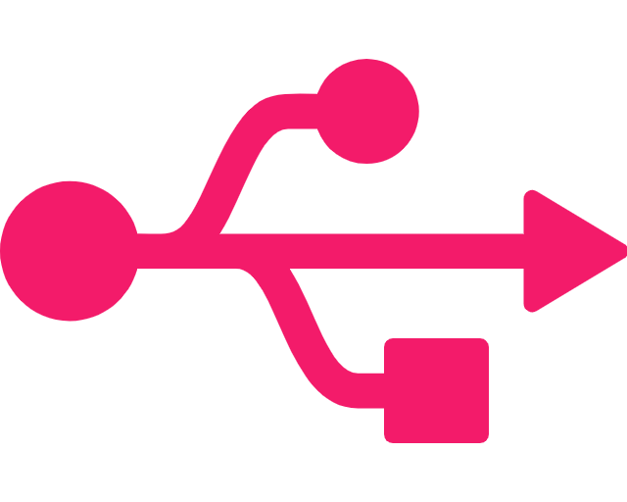



Modern Computer System
CPU
Disk
Controller
USB
Controller
Graphics
Adapter
App
Memory
Notes:
A device driver is a software program that manages and controls a specific device that is attached to a computer, while a device controller is a hardware unit that makes sense of the incoming and outgoing signals of the CPU. Device controller works like an interface between device driver and device.

Slide 46
Computer System Architecture
HDD
Processor Socket
Processor
Core 2
L3
R
L1
L2
Main Memory
R
L1
R
Core 1
R
L1
L2
R
L1
R

Slide 47
Computer System Architecture
CPU State
CPU State
CPU State
Interrupt Logic
Interrupt Logic
Interrupt Logic
Execution Unit
Execution Unit
Execution Unit
Execution Unit
Execution Unit
Execution Unit
Single core
Multiprocessor
CPU State
CPU State
Interrupt Logic
Interrupt Logic
Execution Unit
Execution Unit
Execution Unit
Execution Unit
Multicore

Slide 48
How a Modern Computer Works?
Von Neumann Architecture
Instruction execution cycle
Process/Thread
Execution
CPU
Instructions
and
Data
Memory
Data Movement
Data
IO requests
Interrupt
DMA
Devices

Slide 49

Clustered Systems
Input Data
Computer
Root Node
Storage
Node
Results
Computer
Slave Node 1
Computer
Slave Node 2
Computer
Slave Node N

Slide 50

Thank you

